Slide 1
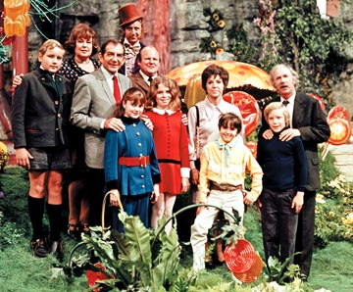
Crazy Characters
In
Charlie and the chocolate Factory
By: Morgan Lamb
Notes:
Picture:http://www.google.com/imgres?hl=en&tbo=d&biw=1366&bih=707&tbm=isch&tbnid=o55vJXPSEoas7M:&imgrefurl=http://basementrejects.com/review/willy-wonka-and-the-chocolate-factory-1971/&docid=CFA2o1kl0Q632M&imgurl=http://basementrejects.com/wp-content/uploads/2012/07/willy-wonka-and-the-chocolate-factory-cast.jpg&w=360&h=298&ei=Q8aiUIHDOeXh0gGr9YCQDg&zoom=1&iact=hc&vpx=12&vpy=193&dur=421&hovh=153&hovw=191&tx=106&ty=110&sig=107181569154577101423&page=1&tbnh=143&tbnw=181&start=0&ndsp=21&ved=1t:429,r:0,s:0,i:86

Slide 2


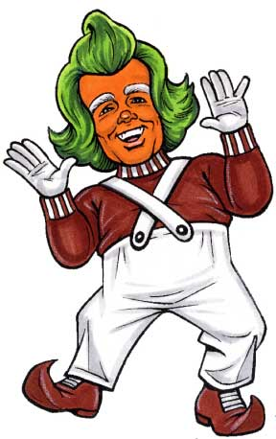

Click here if you do not understand the italicized words!
Hello! I am one of Willy Wonka’s trusted workers here at Wonka’s wondrous factory. I will be introducing you to all of the peculiar characters we have met in the newly opened chocolate factory.
Click me
Notes:
Oompa loompa picture: http://resumecompanion.blogspot.com/2012/04/oompa-loompa-yells-unfair-dismissal-in.html
Candy picture is from clipart
Factory is from clipart

Slide 3
But first, we must go over the button instructions, or we could make Willy Wonka pretty sour!
Go to the next page
Go to the previous page
Character Review
Dictionary for
italicized words
Literary terms
home
Notes:
Oompa loompa picture: http://resumecompanion.blogspot.com/2012/04/oompa-loompa-yells-unfair-dismissal-in.html
Dictionary: Clipart

Slide 4
Characters
So what will it be? Please choose!
Quiz
OR
Literary Terms
Notes:
Oompa loompa picture: http://resumecompanion.blogspot.com/2012/04/oompa-loompa-yells-unfair-dismissal-in.html

Slide 5
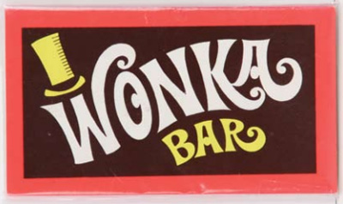
The Description of each
Character is based on the
Reading. This presentation is
Intended to remind You of
each character.
Thank you
Notes:
Chocolate bar:http://questgarden.com/118/63/3/110207165349/images/wonka-bar.jpg

Slide 6
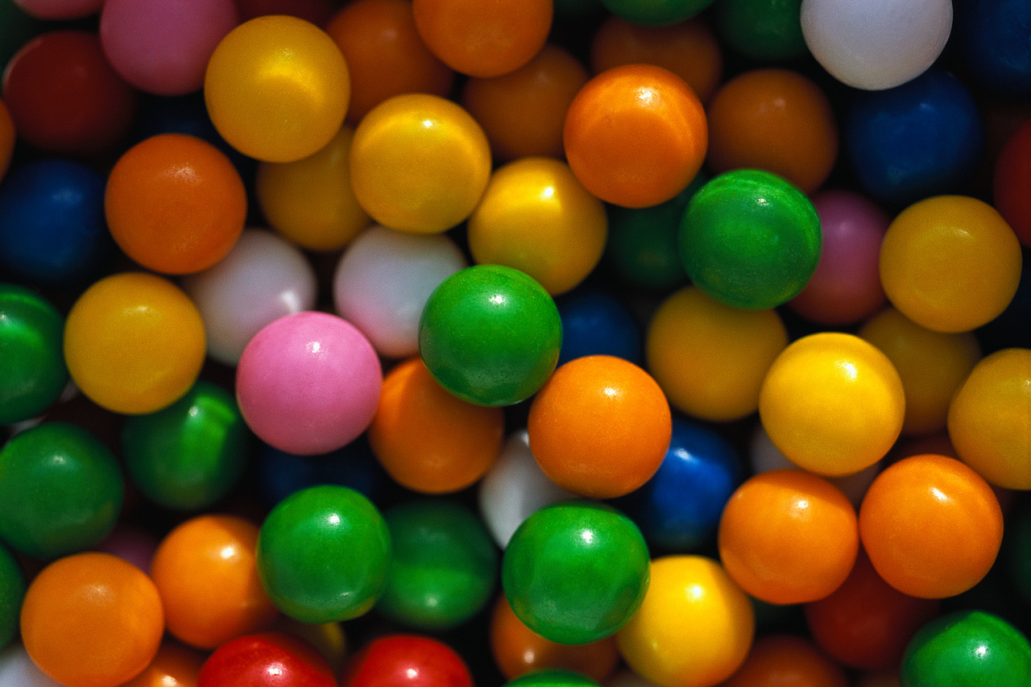
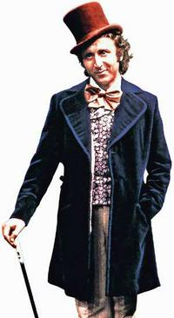
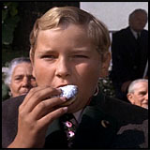
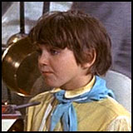
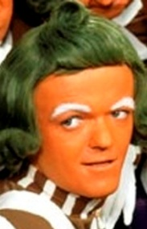
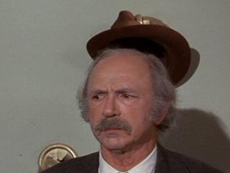
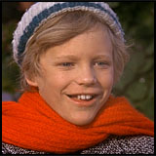
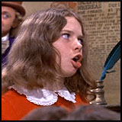
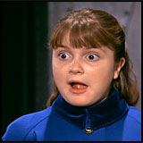
Notes:
Willy Wonka picture: http://www.portlandmercury.com/binary/1df3/1339519114-wonka.jpeg
Bubble gum background is from clipart
Charlie Bucket:http://www.darthsanddroids.net/chocolates/cast/charlie.jpg
Grandpa Joe:http://www.cynical-c.com/archives2/bloggraphics/illmannered.jpg
Mike Teevee:http://www.darthsanddroids.net/chocolates/cast/mike.jpg
Veruca Salt:http://www.darthsanddroids.net/chocolates/cast/veruca.jpg
Violet Beauregarde:http://www.darthsanddroids.net/chocolates/cast/violet.jpg
Augustus Gloop:http://www.darthsanddroids.net/chocolates/cast/augustus.jpg
Oompa Loompa:http://3.bp.blogspot.com/_KqQsYqm5HXQ/TS0BakvQf4I/AAAAAAAAAPo/v9Y-oglGL5k/s1600/oompa+loompa.jpg

Slide 7
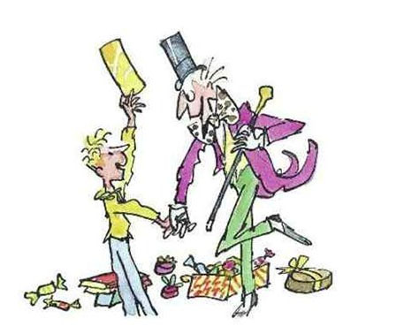
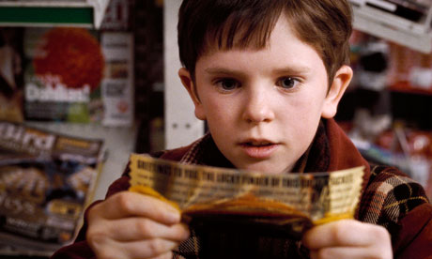
Charlie Bucket
Main Protagonist
One of the Golden ticket recipients
Selected to take over the factory
Very selfless
Comes from a poor family
Notes:
Roald Dahl Charlie:http://1.bp.blogspot.com/-eNaAosvolRM/TbmIA6lt2qI/AAAAAAAAAAM/KPJeBSuurBk/s1600/char.jpg
Charlie and the Golden ticket: http://static.guim.co.uk/sys-images/Books/Pix/pictures/2011/9/9/1315580119593/Charlie-Bucket-in-the-fil-006.jpg

Slide 8
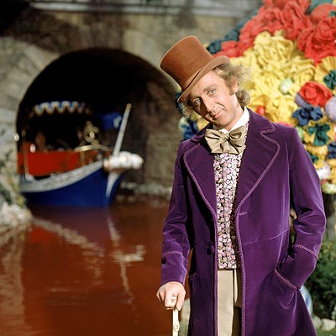
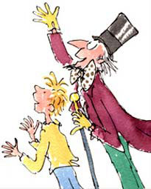
Willy wonka
Major character
Owns the Chocolate Factory
Guides the tour during the sweepstake
Invents the curious candy fixtures
Notes:
Live Willy Wonka photo: http://blogs.houstonpress.com/eating/willy-wonka-in-chocolate-factory.jpg
Cartoon Willy Wonka:http://www.randomhousesites.co.uk/childrens/roalddahl/day/images/links/leftTail.jpg

Slide 9
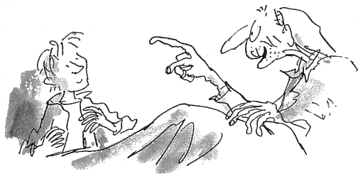
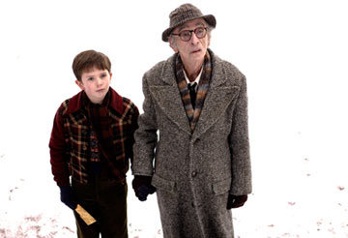
Grandpa Joe
Charlie’s Grandfather
Charlie chooses him to come to the factory.
Warns Charlie of Wonka’s rules.
Helps Charlie through his experience.
Notes:
Grandpa Joe Roald Dahl:http://2.bp.blogspot.com/-OzzuTIjZS1s/TZpnazPytaI/AAAAAAAAAP4/PEw8tidTeAg/s1600/2.gif
Grandpa Joe Movie:http://www.fanpop.com/images/polls/9205_2_full.jpg
Turtles: clipart

Slide 10
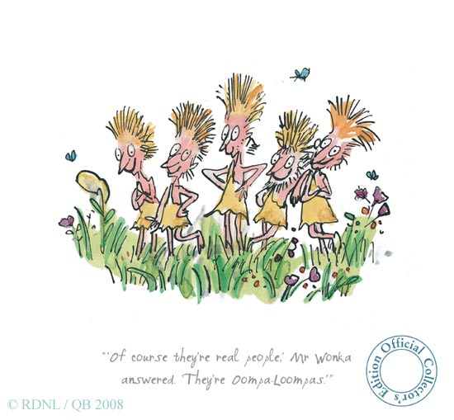
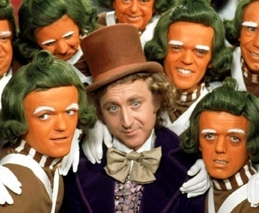
Oompa Loompas
From Loompaland , a small region in Africa (fictional)
Willy Wonka saved them from their dangerous homes
Originally hunted by predators
Work in Wonka’s factory
Notes:
Oompa and Willy: http://images2.fanpop.com/images/quiz/274000/274630_1249982674323_348_286.jpg
Dahl oompa:http://2.bp.blogspot.com/_phdT86kj4Jw/TDU4kNs-VsI/AAAAAAAABiQ/aB3d0X1f47A/s1600/RD9104_large.jpg

Slide 11
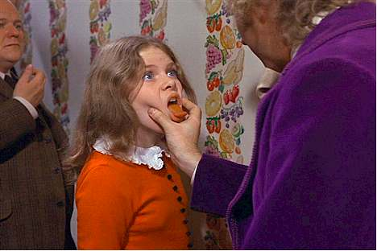
Veruca Salt
Wealthy Background
Selfish
Very demanding
A “bad nut”
Notes:
Veruca Movie:http://blog.southeastpsych.com/wp-content/uploads/2011/07/ODD-Veruca-Salt.jpg
Necklace: clipart

Slide 12

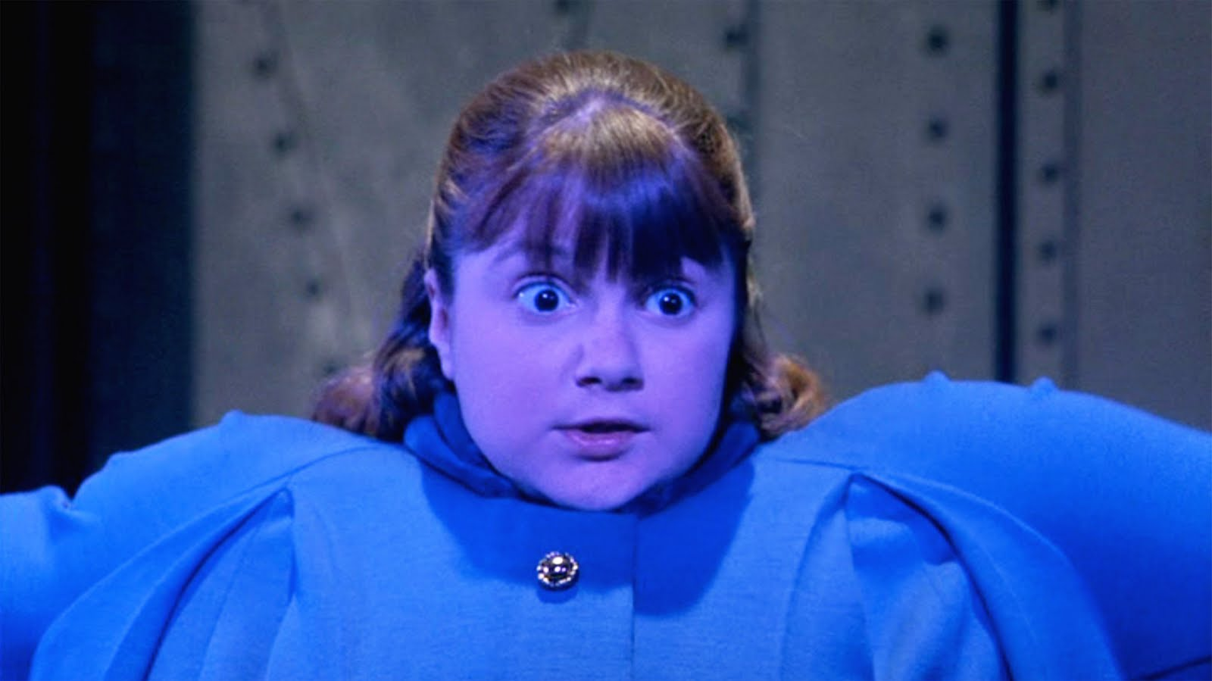
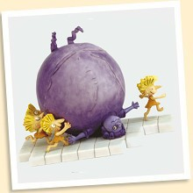
Violet Beauregarde
Competitive “Gum chewer”
Third contestant to find the golden ticket
Turns into a blueberry
Notes:
Blue Violet:http://3.bp.blogspot.com/-Y-dDE2zd7I0/TmdH77_fsoI/AAAAAAAACJc/v8LxdgnLhok/s1600/WillyWonka_163Pyxurz.jpg
Blueberry: Clipart
Violet Dahl:http://www.roalddahlstore.com/Images/products/violet-l.jpg

Slide 13

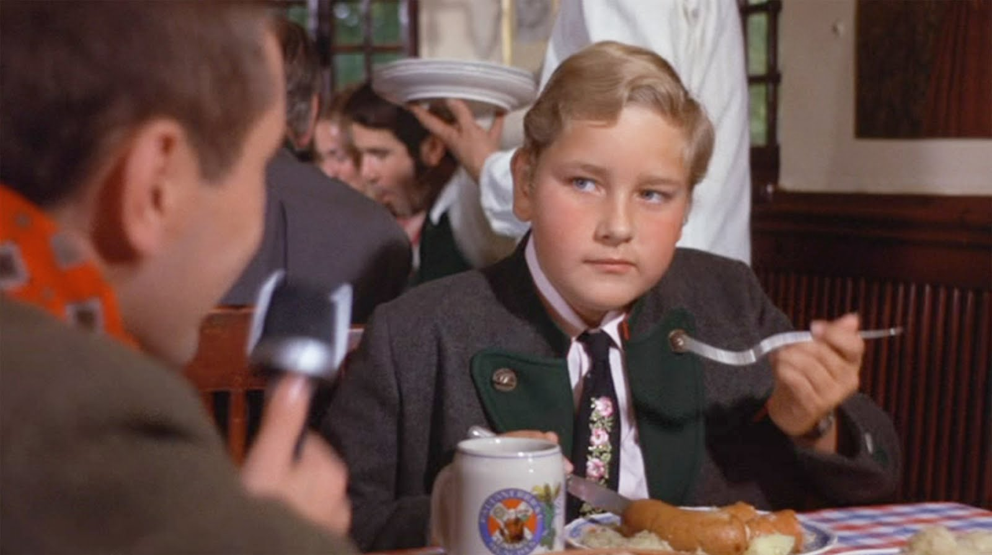
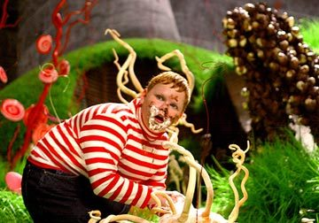
Augustus Gloop
From Germany
Gets sucked in the chocolate river
First contestant to leave the factory
Notes:
August Gloop movie:http://www.fanpop.com/images/polls/9204_2_full.jpg
Augustus Gloop old movie:http://4.bp.blogspot.com/-mjNvOA_JSRA/TmdFHBKADWI/AAAAAAAACGk/3VAWCbVKFwI/s1600/WillyWonka_034Pyxurz.jpg
Chocolate bunnies: clipart

Slide 14

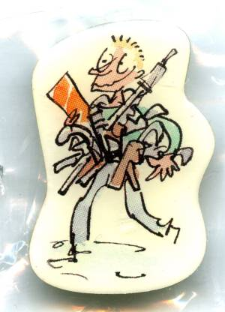
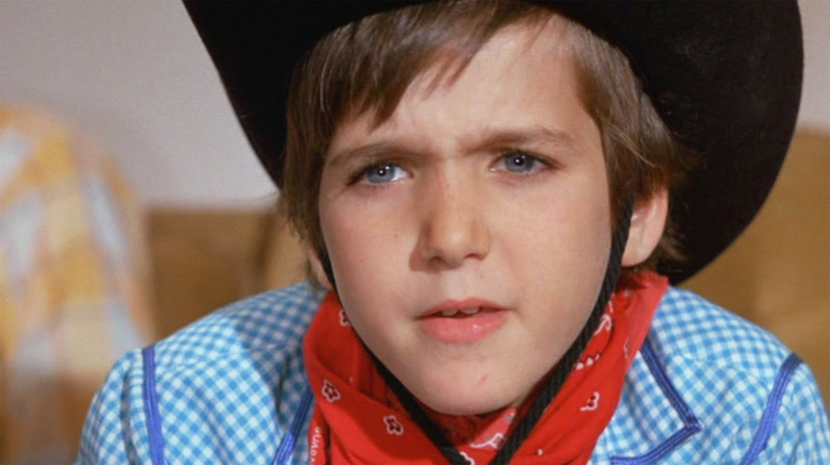
Mike Teavee
Obsessively watches T.V.
The last contestant to leave the factory.
He owns 19 pistols.
Notes:
Dahl Mike:http://byegolly.co.uk/index_files/dahl%20badges/Mike%20Teavee.jpg
Mike movie:http://4.bp.blogspot.com/-jEjXZ9pT7_g/TmdFmMTeE7I/AAAAAAAACHE/8kdjPAqzFVE/s1600/WillyWonka_057Pyxurz.jpg
Gun is clipart, boy with squirt gun is clipart

Slide 15

Literary terms
Protagonist
Antagonist
Minor Character
Theme
Sarcasm
Deuteragonist
Characterization
Please click on as many as you would like
Notes:
Clip art photos

Slide 16

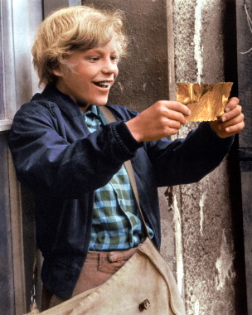
Protagonist
Main character of the story or novel, deals with conflict throughout the story
Example:
Charlie Bucket
Notes:
Charlie:http://www.moviemarket.com/library/photos/280/280374.jpg

Slide 17
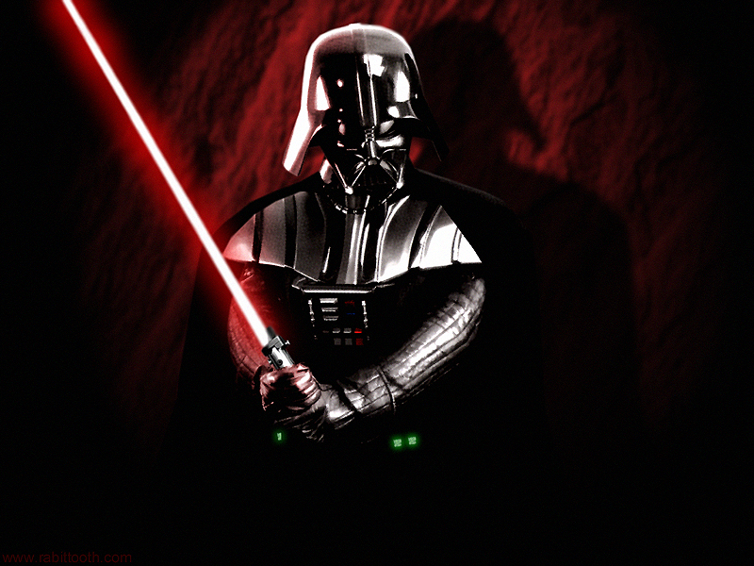
Antagonist
The character who opposes the protagonist or creates conflict in the story.
This is not an actual character in the book, this is just an example.
Example:
Darth Vader
Notes:
Darth Vader:http://images.wikia.com/adventuretimewithfinnandjake/images/8/84/Darth-vader.jpg

Slide 18
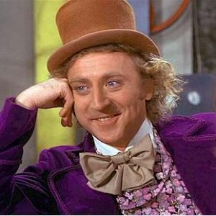
Deuteragonist
The second main character in a story. They play an important role, but do not function as the main protagonist.
Example:
Willy Wonka
Notes:
Willy wonka: http://www.pressingsave.com/golfpro/wp-content/uploads/2012/07/Willy-Wonka.jpg

Slide 19


Minor Characters
Character that appears in the story multiple times but is not the main character.
Examples:
Violet Beauregarde
Veruca Salt
Mike Teavee
Notes:
Veruca Movie:http://blog.southeastpsych.com/wp-content/uploads/2011/07/ODD-Veruca-Salt.jpg
Blue Violet:http://3.bp.blogspot.com/-Y-dDE2zd7I0/TmdH77_fsoI/AAAAAAAACJc/v8LxdgnLhok/s1600/WillyWonka_163Pyxurz.jpg
Mike movie:http://4.bp.blogspot.com/-jEjXZ9pT7_g/TmdFmMTeE7I/AAAAAAAACHE/8kdjPAqzFVE/s1600/WillyWonka_057Pyxurz.jpg

Slide 20
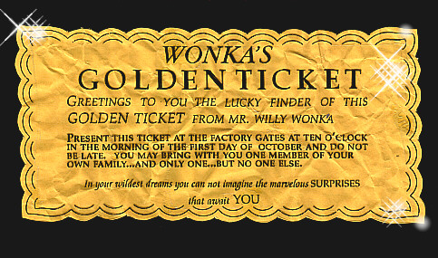
Theme
The central topic, or general idea of a story.
Which contestant was the perfect choice for the chocolate factory ?
Notes:
Golden ticket: http://3.bp.blogspot.com/-On3RZpBfNkA/Ts4SJp5RuPI/AAAAAAAAAIk/cdTMySHE_Ik/s1600/wonkagoldticket1pb0.jpg

Slide 21
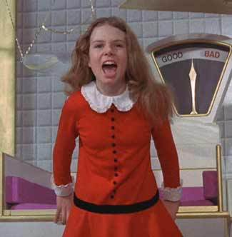
Characterization
Description of a character’s contribution and mannerisms. Specific words to develop a feel for the character.
Example: Veruca is described as very snotty, greedy, and demanding.
Notes:
Veruca Salt:http://www.trada.com/wp-content/uploads/2011/07/veruca_salt.jpg

Slide 22
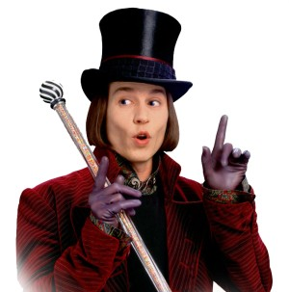
Sarcasm
a mode of satirical wit depending for its effect on bitter, caustic, and often ironic language that is usually directed against an individual.
Willy Wonka uses sarcasm often through the novel and the movie interpretations.
Notes:
Definition: http://www.merriam-webster.com/dictionary/sarcasm
Willy wonka:http://www.passivemoneytalk.com/wp-content/uploads/2012/03/Willy.jpg

Slide 23

Quiz question #1
Who is the protagonist of the book, Charlie and the Chocolate Factory ?
Charlie Bucket
Augustus Gloop
Willy Wonka
Notes:
Live Willy Wonka photo: http://blogs.houstonpress.com/eating/willy-wonka-in-chocolate-factory.jpg
Charlie and the Golden ticket: http://static.guim.co.uk/sys-images/Books/Pix/pictures/2011/9/9/1315580119593/Charlie-Bucket-in-the-fil-006.jpg
August Gloop movie:http://www.fanpop.com/images/polls/9204_2_full.jpg

Slide 24

Try again!
Sorry, August Gloop is a minor character in the book!
Notes:
No sign:http://4.bp.blogspot.com/_WsE6M_RjBIY/RzqTMFePbQI/AAAAAAAAFEU/KlmVGt_vlCI/s1600/no+sign.JPG
Oompa loompa picture: http://resumecompanion.blogspot.com/2012/04/oompa-loompa-yells-unfair-dismissal-in.html

Slide 25
Try again!
Willy Wonka can be considered the Deuteragonist. You can get the right answer!
Notes:
No sign:http://4.bp.blogspot.com/_WsE6M_RjBIY/RzqTMFePbQI/AAAAAAAAFEU/KlmVGt_vlCI/s1600/no+sign.JPG
Oompa loompa picture: http://resumecompanion.blogspot.com/2012/04/oompa-loompa-yells-unfair-dismissal-in.html

Slide 26
Great Job!
Go to the next Question

Slide 27
Quiz Question #2
Who is considered a minor character in Charlie and the Chocolate Factory?
Veruca Salt
Oompa Loompa
Charlie Bucket
Notes:
Charlie:http://www.moviemarket.com/library/photos/280/280374.jpg
Veruca Salt:http://www.trada.com/wp-content/uploads/2011/07/veruca_salt.jpg
Oompa loompa picture: http://resumecompanion.blogspot.com/2012/04/oompa-loompa-yells-unfair-dismissal-in.html

Slide 28
Try again!
Charlie Bucket is the Protagonist. Keep Trying!
Notes:
No sign:http://4.bp.blogspot.com/_WsE6M_RjBIY/RzqTMFePbQI/AAAAAAAAFEU/KlmVGt_vlCI/s1600/no+sign.JPG
Oompa loompa picture: http://resumecompanion.blogspot.com/2012/04/oompa-loompa-yells-unfair-dismissal-in.html

Slide 29
Great Job!
Go to the next Question

Slide 30

Quiz Question #3
Which character in Charlie and the Chocolate Factory is characterized as a T.V. lover and a very competitive shooter?
Mike Teavee
Augustus Gloop
Willy Wonka
Notes:
Mike movie:http://4.bp.blogspot.com/-jEjXZ9pT7_g/TmdFmMTeE7I/AAAAAAAACHE/8kdjPAqzFVE/s1600/WillyWonka_057Pyxurz.jpg
Willy wonka:http://www.passivemoneytalk.com/wp-content/uploads/2012/03/Willy.jpg
August Gloop movie:http://www.fanpop.com/images/polls/9204_2_full.jpg

Slide 31
Try again!
Willy Wonka is much too busy developing new, delicious candy for all to enjoy! Keep trying!
Notes:
No sign:http://4.bp.blogspot.com/_WsE6M_RjBIY/RzqTMFePbQI/AAAAAAAAFEU/KlmVGt_vlCI/s1600/no+sign.JPG
Oompa loompa picture: http://resumecompanion.blogspot.com/2012/04/oompa-loompa-yells-unfair-dismissal-in.html

Slide 32
Try again!
Augustus loves to eat chocolate and munch on sweets! He has very little time to watch T.V.
Keep Trying!
Notes:
No sign:http://4.bp.blogspot.com/_WsE6M_RjBIY/RzqTMFePbQI/AAAAAAAAFEU/KlmVGt_vlCI/s1600/no+sign.JPG
Oompa loompa picture: http://resumecompanion.blogspot.com/2012/04/oompa-loompa-yells-unfair-dismissal-in.html

Slide 33
Great Job!
Go to the next Question

Slide 34

Quiz Question #4
Which character is described (characterized) as being a competitive gum chewer?
Violet Beauregarde
Grandpa Joe
Oompa Loompa
Notes:
Blue Violet:http://3.bp.blogspot.com/-Y-dDE2zd7I0/TmdH77_fsoI/AAAAAAAACJc/v8LxdgnLhok/s1600/WillyWonka_163Pyxurz.jpg
Grandpa Joe Movie:http://www.fanpop.com/images/polls/9205_2_full.jpg
Dahl oompa:http://2.bp.blogspot.com/_phdT86kj4Jw/TDU4kNs-VsI/AAAAAAAABiQ/aB3d0X1f47A/s1600/RD9104_large.jpg

Slide 35
Try again!
It seems to me that Grandpa Joe does not enjoy chewing gum! Please try again!
Notes:
No sign:http://4.bp.blogspot.com/_WsE6M_RjBIY/RzqTMFePbQI/AAAAAAAAFEU/KlmVGt_vlCI/s1600/no+sign.JPG
Oompa loompa picture: http://resumecompanion.blogspot.com/2012/04/oompa-loompa-yells-unfair-dismissal-in.html

Slide 36
Try again!
Oompa Loompas do not enjoy chewing gum. Please try again!
Notes:
No sign:http://4.bp.blogspot.com/_WsE6M_RjBIY/RzqTMFePbQI/AAAAAAAAFEU/KlmVGt_vlCI/s1600/no+sign.JPG
Oompa loompa picture: http://resumecompanion.blogspot.com/2012/04/oompa-loompa-yells-unfair-dismissal-in.html

Slide 37
Great Job!
Go to the next Question

Slide 38
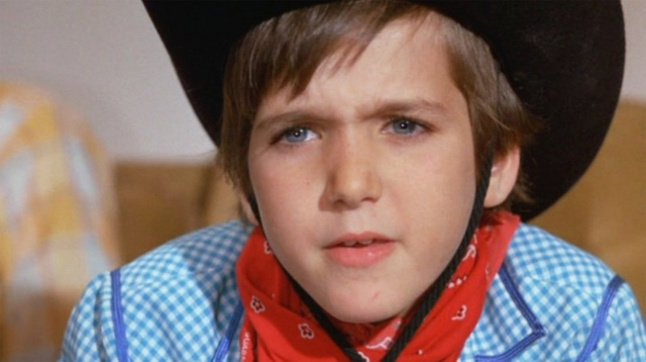
Quiz Question # 5
Who does Willy Wonka give the final prize to?
Charlie Bucket
Veruca Salt
Mike Teavee
Notes:
Mike movie:http://4.bp.blogspot.com/-jEjXZ9pT7_g/TmdFmMTeE7I/AAAAAAAACHE/8kdjPAqzFVE/s1600/WillyWonka_057Pyxurz.jpg
Veruca Movie:http://blog.southeastpsych.com/wp-content/uploads/2011/07/ODD-Veruca-Salt.jpg
Charlie and the Golden ticket: http://static.guim.co.uk/sys-images/Books/Pix/pictures/2011/9/9/1315580119593/Charlie-Bucket-in-the-fil-006.jpg

Slide 39
Try again!
Remember, Veruca is a bad nut! Give it another try!
Notes:
No sign:http://4.bp.blogspot.com/_WsE6M_RjBIY/RzqTMFePbQI/AAAAAAAAFEU/KlmVGt_vlCI/s1600/no+sign.JPG
Oompa loompa picture: http://resumecompanion.blogspot.com/2012/04/oompa-loompa-yells-unfair-dismissal-in.html

Slide 40
Try again!
Mike seems to only like playing with toy guns, I do not think he is cut out for the factory. Don’t quit you can do it!
Notes:
No sign:http://4.bp.blogspot.com/_WsE6M_RjBIY/RzqTMFePbQI/AAAAAAAAFEU/KlmVGt_vlCI/s1600/no+sign.JPG
Oompa loompa picture: http://resumecompanion.blogspot.com/2012/04/oompa-loompa-yells-unfair-dismissal-in.html

Slide 41
Great Job!
Go to the next Question

Slide 42
Quiz Question #6
Please choose the word that matches this definition
Excessive use of some distinct manner or style, particularly of a behavior.
Recipient
Caustic
Mannerisms

Slide 43
Try again!
Here is a hint, the word is also in the definition. Look at the word “manner”.
Notes:
No sign:http://4.bp.blogspot.com/_WsE6M_RjBIY/RzqTMFePbQI/AAAAAAAAFEU/KlmVGt_vlCI/s1600/no+sign.JPG
Oompa loompa picture: http://resumecompanion.blogspot.com/2012/04/oompa-loompa-yells-unfair-dismissal-in.html

Slide 44
Great Job!
Go to the next Question

Slide 45
Quiz question #7
Please choose the word that matches this definition:
the use of sarcasm
Recipient
Satire
Wondrous

Slide 46
Try again!
Don’t quit now, you are almost done! Try again!
Notes:
No sign:http://4.bp.blogspot.com/_WsE6M_RjBIY/RzqTMFePbQI/AAAAAAAAFEU/KlmVGt_vlCI/s1600/no+sign.JPG
Oompa loompa picture: http://resumecompanion.blogspot.com/2012/04/oompa-loompa-yells-unfair-dismissal-in.html

Slide 47
Great Job!
Go to the next Question

Slide 48
Quiz question #8
Where is Loompaland said to be in the story ?
Paris, France
Underwater
Africa

Slide 49
Try again!
This is where I am from! You can get the answer!
Notes:
No sign:http://4.bp.blogspot.com/_WsE6M_RjBIY/RzqTMFePbQI/AAAAAAAAFEU/KlmVGt_vlCI/s1600/no+sign.JPG
Oompa loompa picture: http://resumecompanion.blogspot.com/2012/04/oompa-loompa-yells-unfair-dismissal-in.html

Slide 50
Great Job!
Go to the next Question

Slide 52
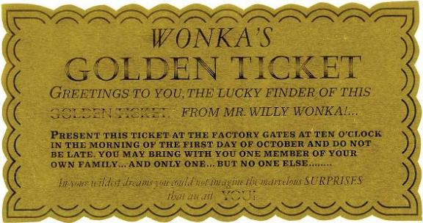
Congratulations
You beat the odds! You may now print out a
golden ticket of your own!
Notes:
Golden ticket: http://www.thesmartkitchenblog.com/wp-content/uploads/2012/04/0_22-Original-screen-used-Golden-Ticket-from-Willy-Wonka-the-Chocolate-Factory1.jpg

Slide 53

Caustic- sarcastic; biting.
Fixture- anything firmly in place.
Mannerisms- Excessive use of some distinct manner or style, particularly of a behavior.
Obsess- to haunt or trouble in mind.
Oppose- to place opposite, resist.
Peculiar- odd; strange.
Predator- living thing that preys on other animals.
Recipient- one that receives.
Satire- the use of sarcasm.
Selfish- having or showing too much concern for one’s own interests.
Selfless- having or showing devotion to others.
Sour- distasteful; unpleasant.
Sweepstake- a lottery in which each participant puts up money in a common fund that is given to the winner as determined in the contest.
Wondrous- wonderful; surprisingly
Notes:
Dictionary: https://encrypted-tbn3.gstatic.com/images?q=tbn:ANd9GcRwDp36dQTkZgXAaO0D9q9Ft--O-nRaG1bw9Tc67H0v2CsRgzMenw
All definitions were looked up in Webster’s New World Dictionary
Citation: Webster’s Newworld Dictionary. Fourth ed. 2003. 1-753. Print.

